Slide 1
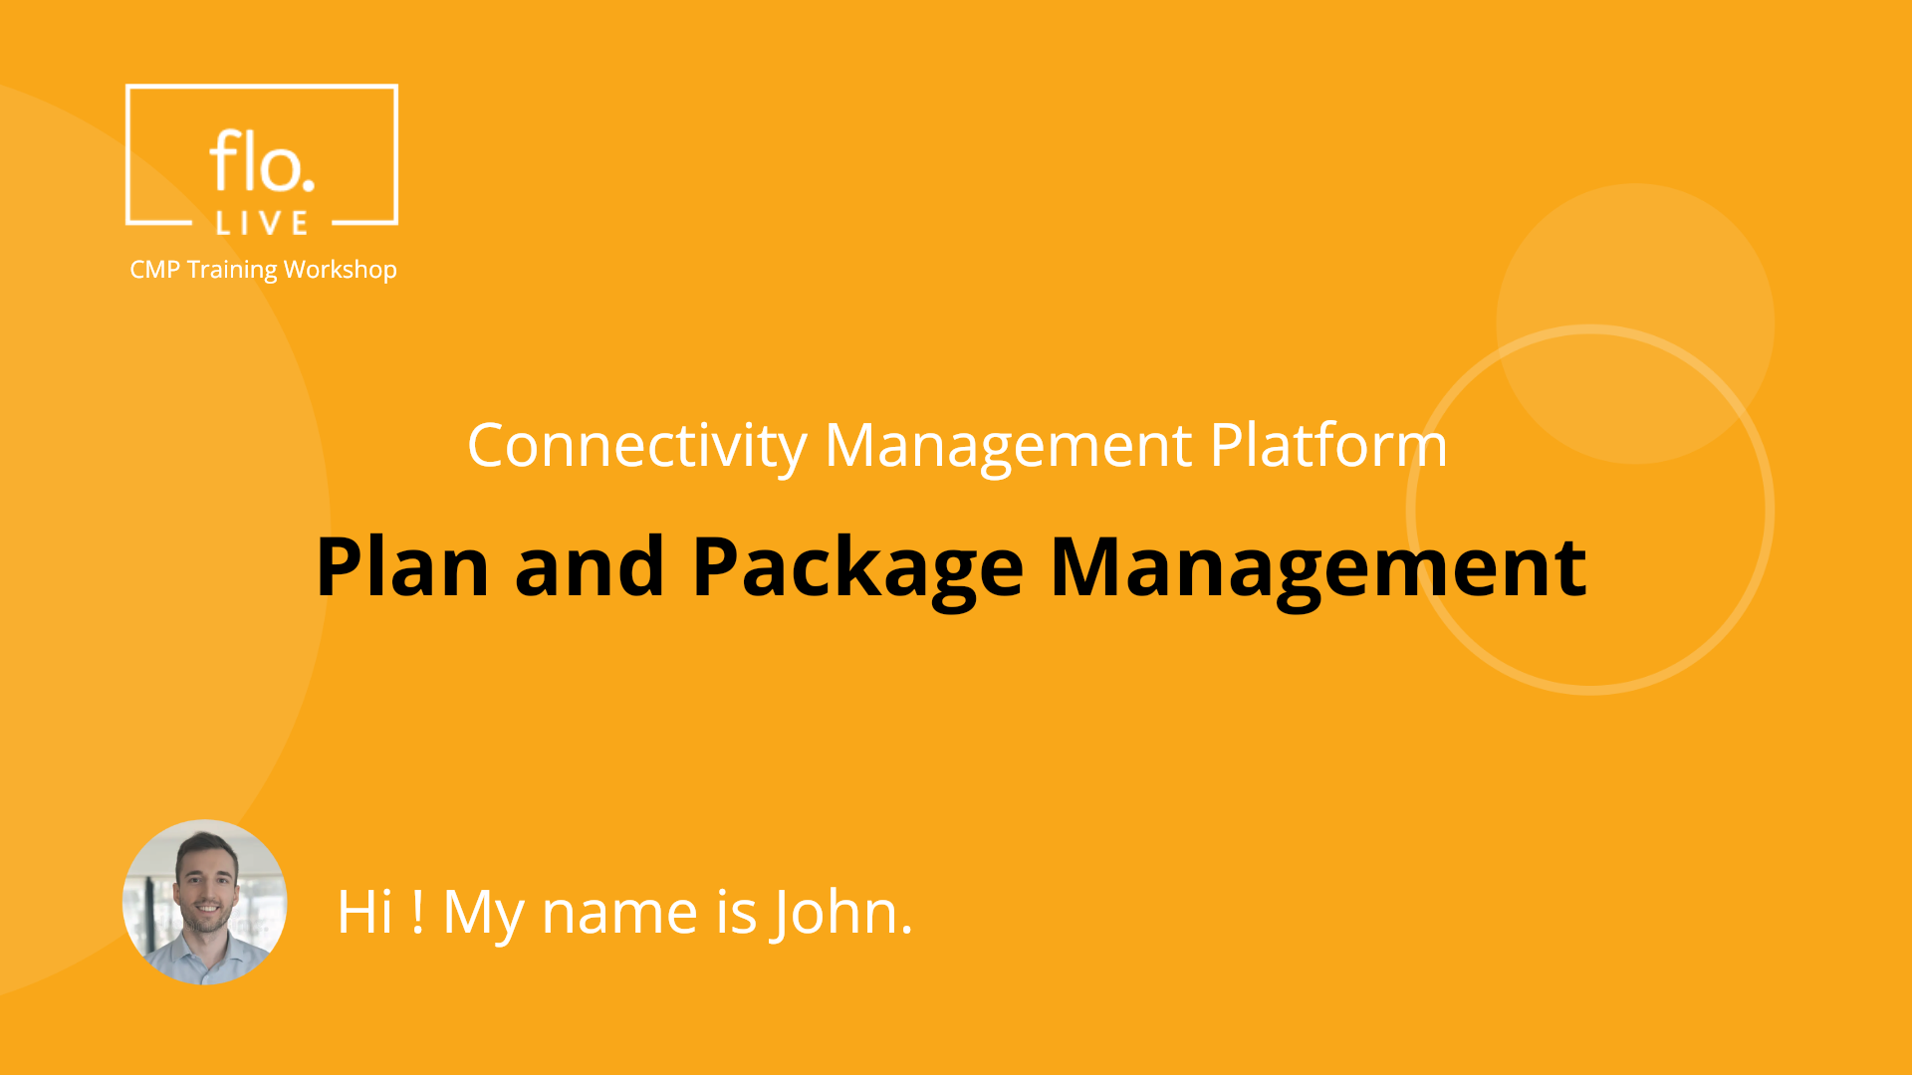
Notes:
Hi !My name is John and welcome to the CMP Training Workshop. In this tutorial we introduce the main features of the CMP Plan and Package Management module. Let's begin.

Slide 2
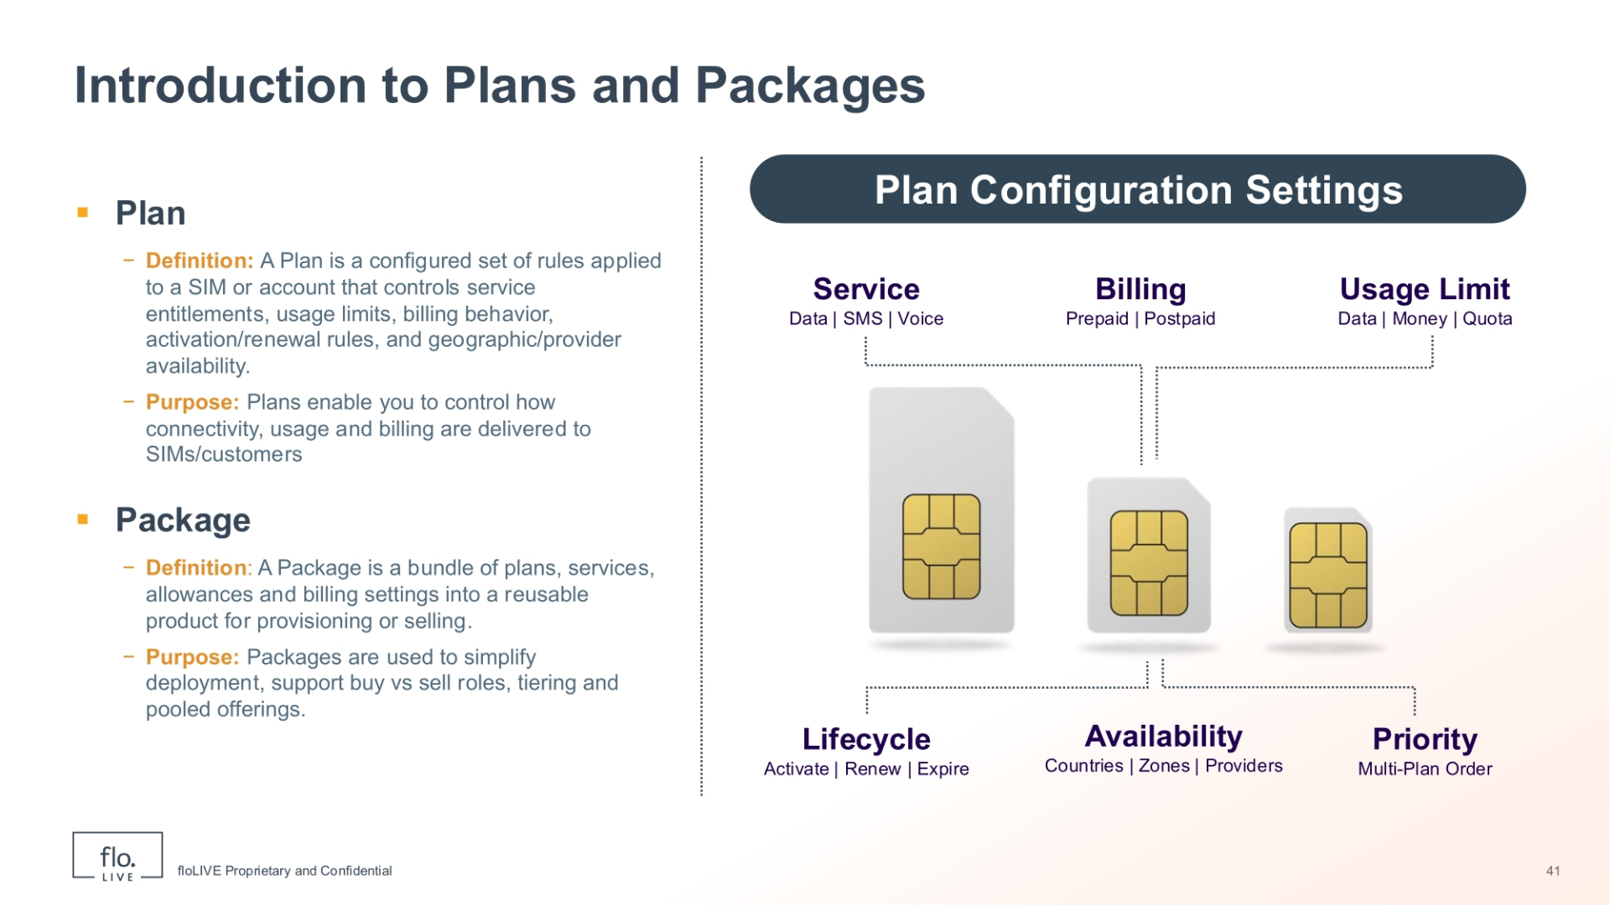
Notes:
We begin this tutorial by introducing two central concepts in the CMP system: Plans and Packages.
A Plan is a configurable set of operational rules applied to a SIM or account. It defines what services the SIM can use such as data, SMS or voice. A plan also defines how charging is handled, as well as the usage limits or monetary caps; Each plan includes lifecycle rules such as activation, renewal and expiration. Plans also include availability controls, and runtime policies such as thresholds and priorities for multi-plan setups. Now lets describe the Package concept. A Package is the commercial bundle you create from one or more plans and settings. It consolidates services, allowances, billing options and applicability rules so you can reuse and deploy configurations quickly. Packages support business roles — for example buy vs sell — and enable tiered, pooled or multi-plan offerings to meet different pricing and operational needs. In summary, plans define how a SIM behaves. In contrast packages convert those plans into a reusable package to simplify provisioning and sale.

Slide 3
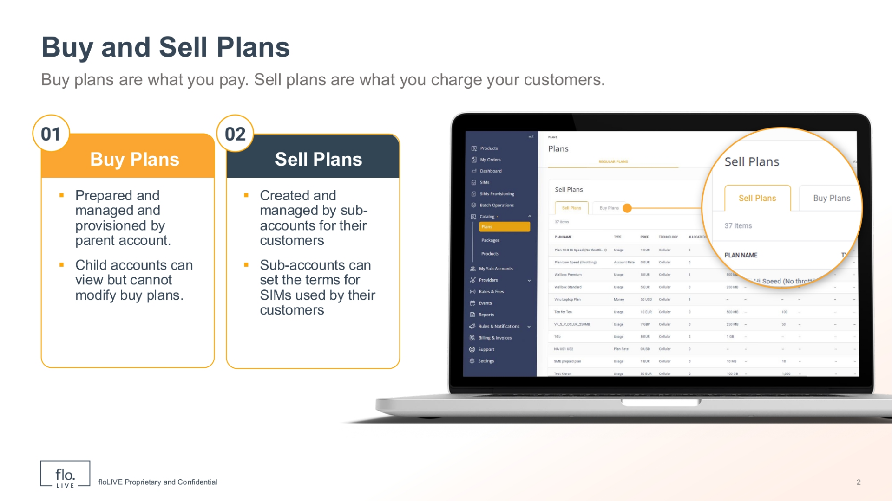
Notes:
The CMP handles two main types of Plans called"Buy Plans", and "Sell Plans".
Buy plans are the services and data limits that you, as the main account, purchase from your parent account. As a parent account, you can set up and manage these plans for use by your customers. Your customers are also referred to as child accounts, or sub-accounts. Your sub-accounts can see these buy plans but cannot change them. On the other hand, Sell Plans are the services that sub-accounts create and manage for their customers. Sub-accounts can set their own rules for SIMs used by their customers. This two-part system clearly separates the plans that you buy from the plans that you sell to your customers.

Slide 4
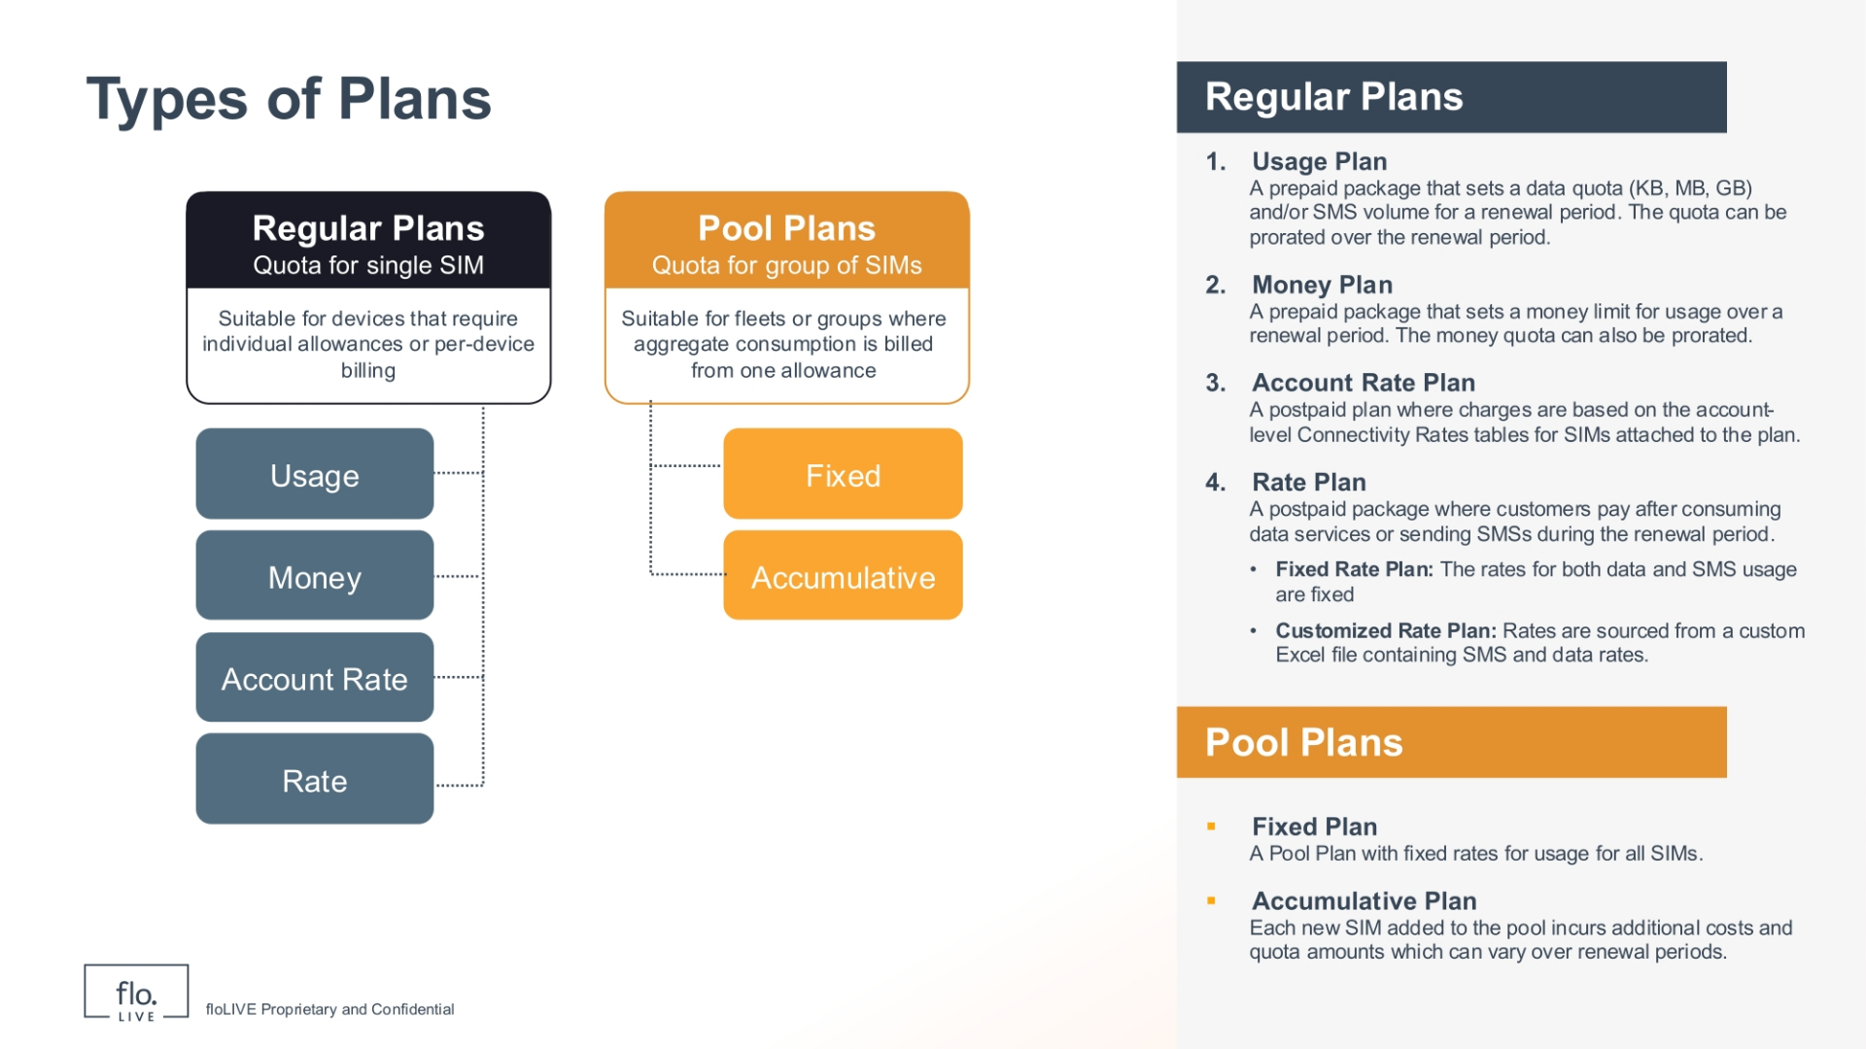
Notes:
Now that we understand the difference between Buy Plans and Sell plans, let's explore the various types of plans available within the CMP. The CMP offers many types of plans to fit different business needs. We divide these into two main groups: Regular Plans and Pool Plans.
Let's take a look at Regular Plans: The first type of regular plan is called a Usage Plan: This type of plan is a simple prepaid plan. The plan includes a set amount of data or number of SMS messages for a specified period of time. A second type of regular plan is called a Money Plan: This type of plan is also prepaid, and it is based on a fixed money limit for how much you can use over a defined period of time. A third type of regular plan is called an Account Rate Plan: This is a postpaid plan, and your charges are based on the CMP rates table for SIMs connected to this plan. Finally we refer to the Rate Plan, which is another type of postpaid plan. Customers pay after they use data or send SMS messages during the plan period. Rate plans can be set at an Account Rate, where data and SMS costs are taken from the CMP Rates table, or at a Fixed and Customized Rate, where costs are defined in the plan settings and can be uploaded by an Excel file. A second catergory of plans are called "Pool Plans". In general, A Pool Plan is a single pre‑paid plan where data, minutes, and/or messages are shared by all SIMs from a common quota. This means that all usage is deducted from the shared pool, and individual SIMs can draw from the pooled quota as needed.
A Fixed Pool Plan means the costs for all SIMs in the group. are fixed and do not change.
In contrast, an Accumulative Plan is different. For this type of plan, every new SIM added to the group adds more costs and data limits. Pool plans are good for sharing resources among many devices efficiently.

Slide 5
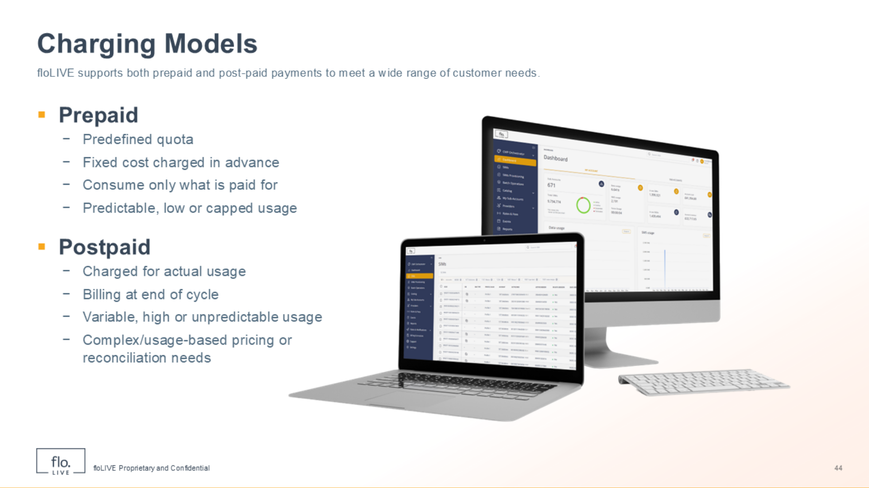
Notes:
Now that you have a clear understanding of the different plan types, let's examine how charges are handled and the various settings you can use to customize these plans. In general, we offer both Prepaid and Postpaid options.
Prepaid models mean you set a fixed cost upfront for a set amount of services. Customers only use what you have set and this is a good model for usage that is steady, relatively low, or has a clear limit. In contrast, Postpaid models charge customers for what they actually use, and they get a bill at the end of the billing period. This model is best for high volume usage , or for charges that are difficult to predict. The Postpaid model also works well for complex pricing based on usage. Having both options means businesses can choose the best billing method for their customer needs.

Slide 6
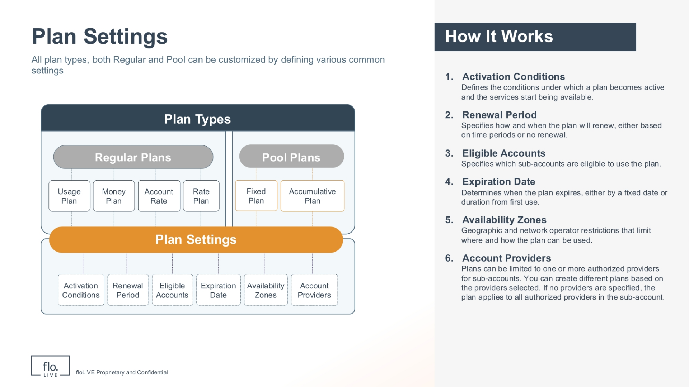
Notes:
Moving forward, we now review the plan settings that give you precise control over each plan. All plans, whether Regular or Pool, can be configured and set up in many ways using common settings. These settings give you precise control over how each plan works.
The Activation Rule, determines when a plan starts and when its services become available.
The Renewal Period, determines how and when a plan will renew. You can choose to renew a plan based on set duration of time such as a week; a month; a year; or choose not to renew at all. The Eligible Accounts setting, determines which sub-accounts are allowed to use a specific plan.
The Expiration Date determines when a plan is due to end. This can be a fixed date, or a specified time after the plan is first used.
Availability Zones determine where and when a plan can be used, based on location and network operator. We discuss Availability plans in more detail, later in this video.
The Account Provider settings enable you to limit a plan to one or more approved providers. If you do not choose any providers, the plan will work for all approved providers in the sub-account.
In summary, the plan settings provide you with alot of flexibility and enable you to create plans that are very specific for your customer needs.

Slide 7

Notes:
Now, let's follow a plan throughout its entire journey, from when the plan starts, to when it renews, or ends. This is called the "Plan Lifecycle".

Slide 8
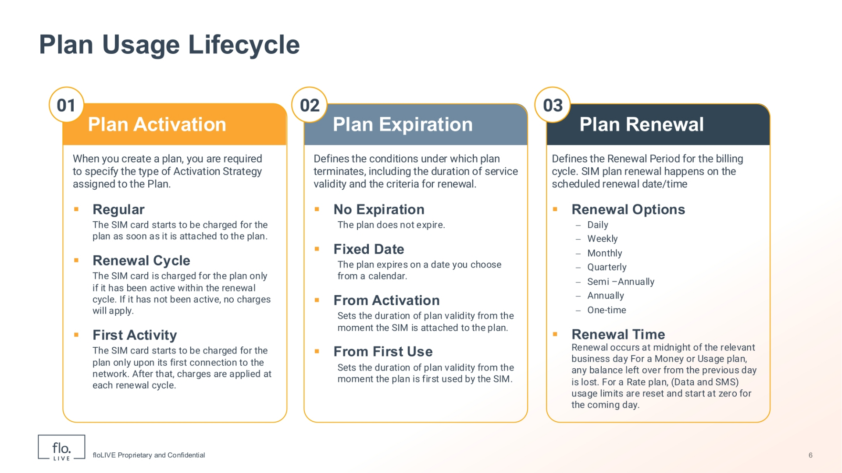
Notes:
When you create a Plan, you must choose how it will start. This first stage of the lifecycle is referred to as "Plan Activation".
For Regular Activation, the SIM card is charged for the plan as soon as it is attached to a plan. When you choose Renewal Cycle, the SIM is charged only if it has been active during the renewal period. If the SIM was not active, no charges are billed.
Finally, the First Activity option means that charges begin when the SIM first connects to the network. After that, charges are billed at each renewal period.
The second stage of the Plan Lifecycle is called Plan Expiration. No Expiration means the plan continues forever.
The Fixed Date option means the plan ends on a date of your choice.
The "From Plan Allocation" option means the plan lasts for a specified duration of time from when the SIM is attached to a plan. and finally, the From Plan First-Use option means that the plan lasts for a specified duration of time starting from when the plan is first used. The third stage of the Plan Lifecycle is called Plan Renewal. This stage determines when a plan renews and the billing cycle begins again. The renewal cycle occurs on a specific date and time. The renewal options include: Daily; Weekly; Monthly; Quarterly; Semi-Annually; Annually; or a One-time renewal date. For Money or Usage plans, any money or data left from the day before is lost when the plan renews.
For Rate plans, the limits for data and SMS use are reset to zero for the new period.

Slide 9
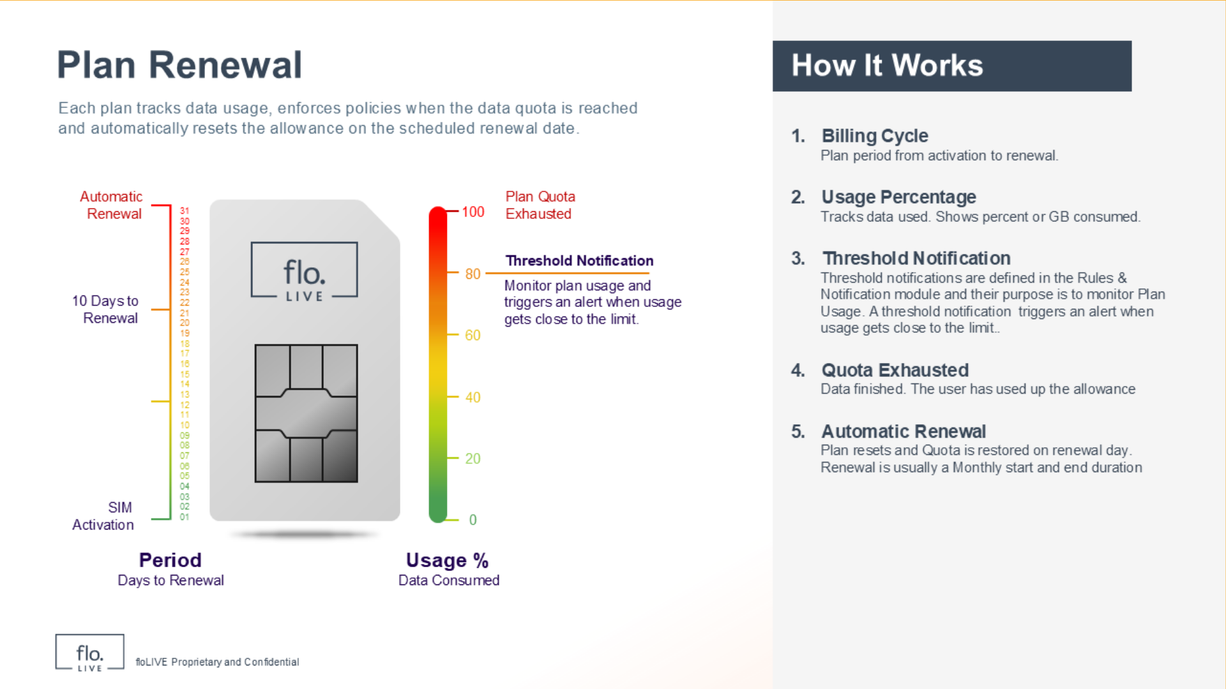
Notes:
Let's take a closer look at how plan renewal works. When activated, each plan tracks data usage and takes action when the data limit is reached . You should note that the data allowance is automatically reset on the planned renewal date.
There are several key concepts that come into play during the plan renewal stage: The Plan Renewal Cycle refers to the time period of the plan, from when it starts to when it renews. Usage shows how much data has been used and this metric is usually displayed as a percentage or in gigabytes. Threshold notifications monitor plan usage and can be set in the Rules and Notifications module. These notifications serve as an early warning to inform the user when their data usage is getting close to the limit. Quota Exhausted means the SIM has used up all its allocated data.
Automatic Renewal means that the plan is reset, and the data limit is restored based on a scheduled date. Renewal usually happens every month, marking the start and end of the period.

Slide 10
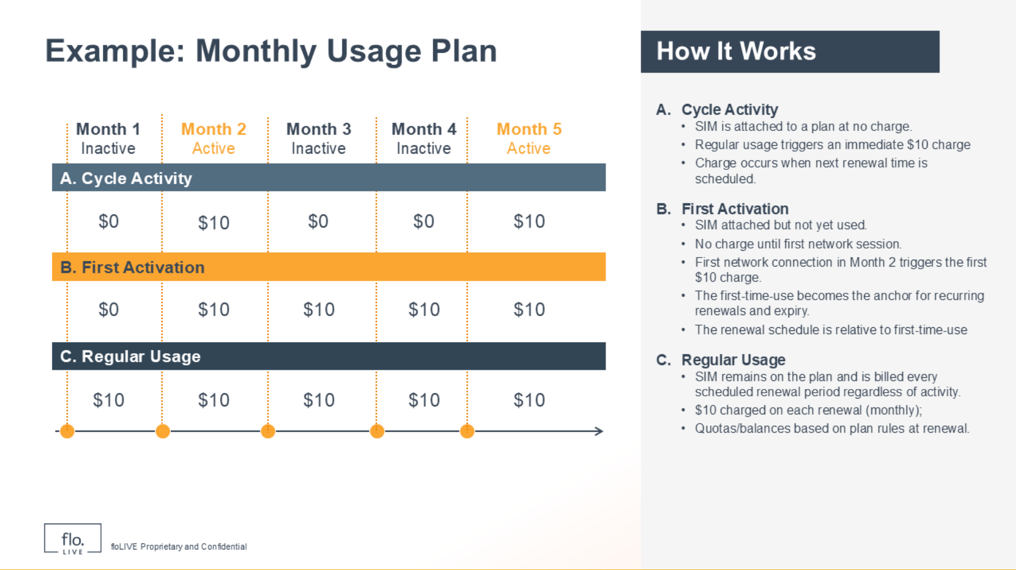
Notes:
Let's walk through the Renewal process using actual data for a Usage Plan that costs $10 per month .
In Row A, the Cycle Activity shows that when a SIM is attached to a plan there is no initial charge. It also shows that SIM usage leads to a monthly charge of 10 dollars when the SIM is used.
Now take a look at Row B to see what happens after First Activation. If a SIM is attached to a plan, but not yet used, then no charges are made. However, when the SIM first connects to the network in Month 2, notice that this initiates a $10 charge. The first use date becomes the fixed point for all future renewals and end dates. In other words, the renewal schedule is based on this first activation.
Lets go to Row C and see how Regular Usage works:
During regular usage, the SIM is charged $10 per month for each renewal period, even if it is not active. The data limits or balances are reset based on the plan rules at each renewal.
This example shows you how charges can differ, based on when the plan is activated.

Slide 11

Notes:
This section explains the concept of Multi-plans, and how they can be used to make sure your SIMs have access to connectivity services based on customer agreements. You will also learn how multi-plans enable you to create flexible charging models.

Slide 12
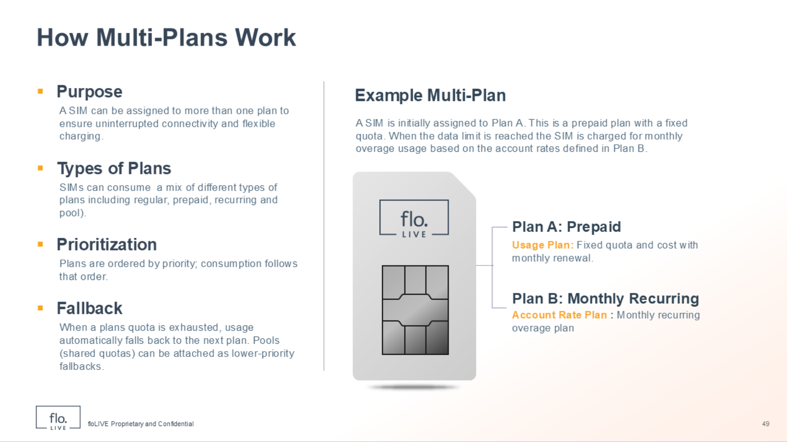
Notes:
The main purpose of a multi-plan is to allow each SIM card to use more than one plan during the billing cycle. Each plan includes a defined set of services allocated to the SIM. This means the when you create a multi-plan, SIMs can use a mix of different plans, including regular; prepaid; recurring; and pool plans. You can assign upto 4 multi-plans per SIM.
Multi-plans are based on the principle of Prioritization and are organized according to order of importance. It works like this: Initially, the SIM consumes data from the primary plan. When a plan runs out of data, usage automatically transfers to the next plan in the order. This method ensures continual service without interruption. Now, let's see how this multi-plan approach can be used to create flexible pricing based on usage levels.

Slide 13
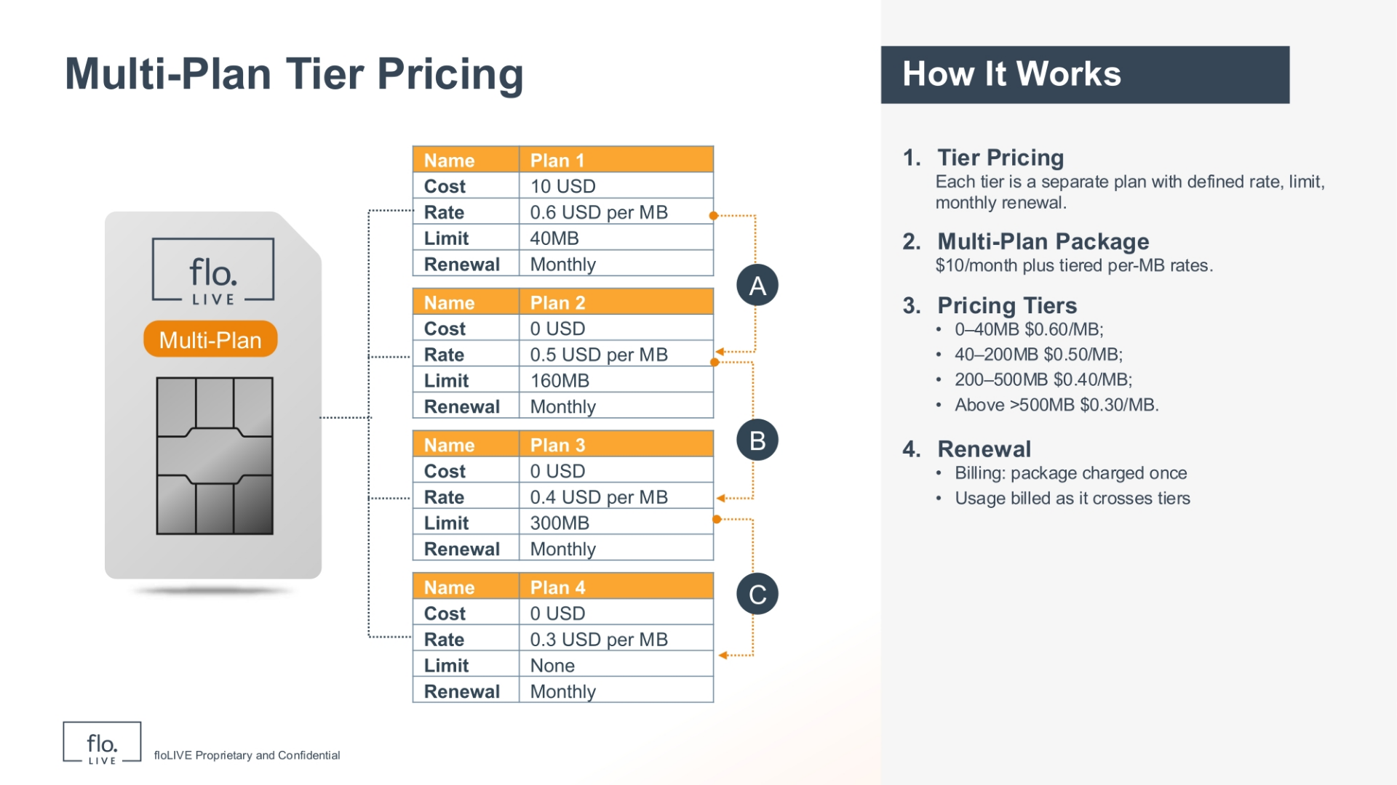
Notes:
The Multi-Plan Tier Pricing method enables you to offer different prices based on how much data is used. This method is called Tier Pricing because each level, or tier, is a separate plan. Each has its own price; usage limit; and monthly renewal schedule. Our example is based on a multi-plan package that costs 10 dollars per month. The package contains 4 different plans each with a different price per megabyte. In our example, we see that the price is reduced when you consume more data. It works like this:
Plan 1: For the first 40 megabytes, you are charged 60 cents per megabyte. This plan renews monthly.
Plan 2 gives you the next 160 megabytes at a lower price of 50 cents per megabyte per month.
Plan 3 gives you the next 300 megabytes at an even lower cost of 40 cents per megabyte. This plan also renews monthly.
Plan 4 is for usage above 500 megabytes and the cost is only 30 cents per megabyte for unlimited usage. Again, this plan also renews monthly.
In this example, you pay for a package containing 4 different plans. You are charged according to your usage pattern. As you consume more data, your are automatically transferred to a different plan at a lower price. This tiered pricing method is very flexible and helps you to manage costs based on how much data is actually used.

Slide 14
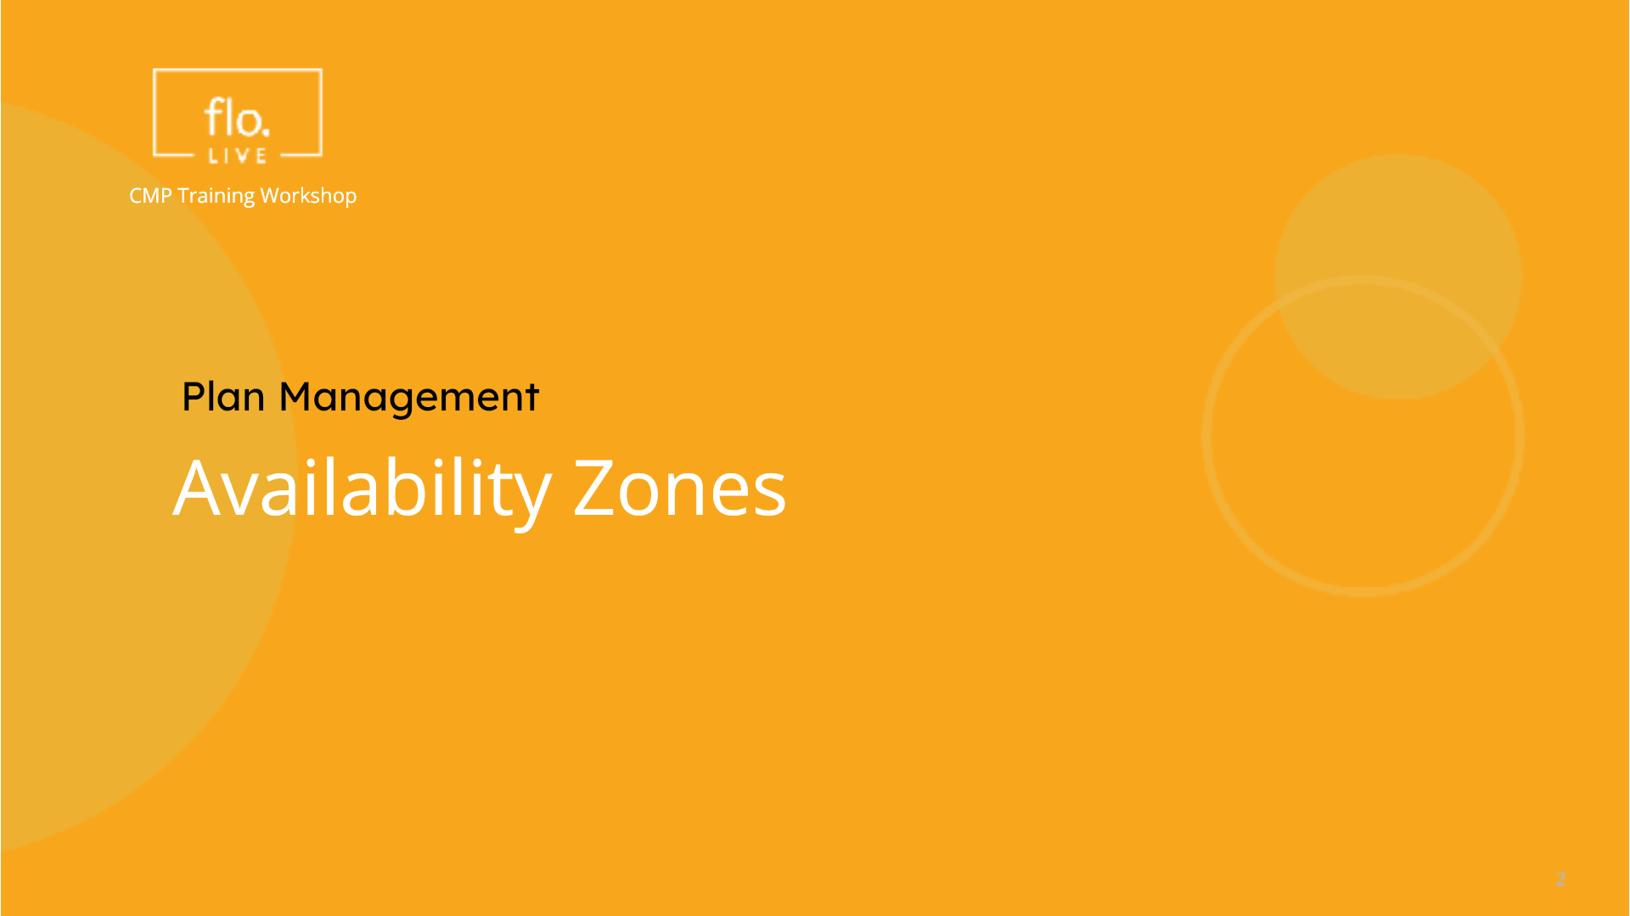
Notes:
In this section, we discover how you can manage where and how your SIMs connect, and how they are charged. This feature is called an Availability Zone.

Slide 15
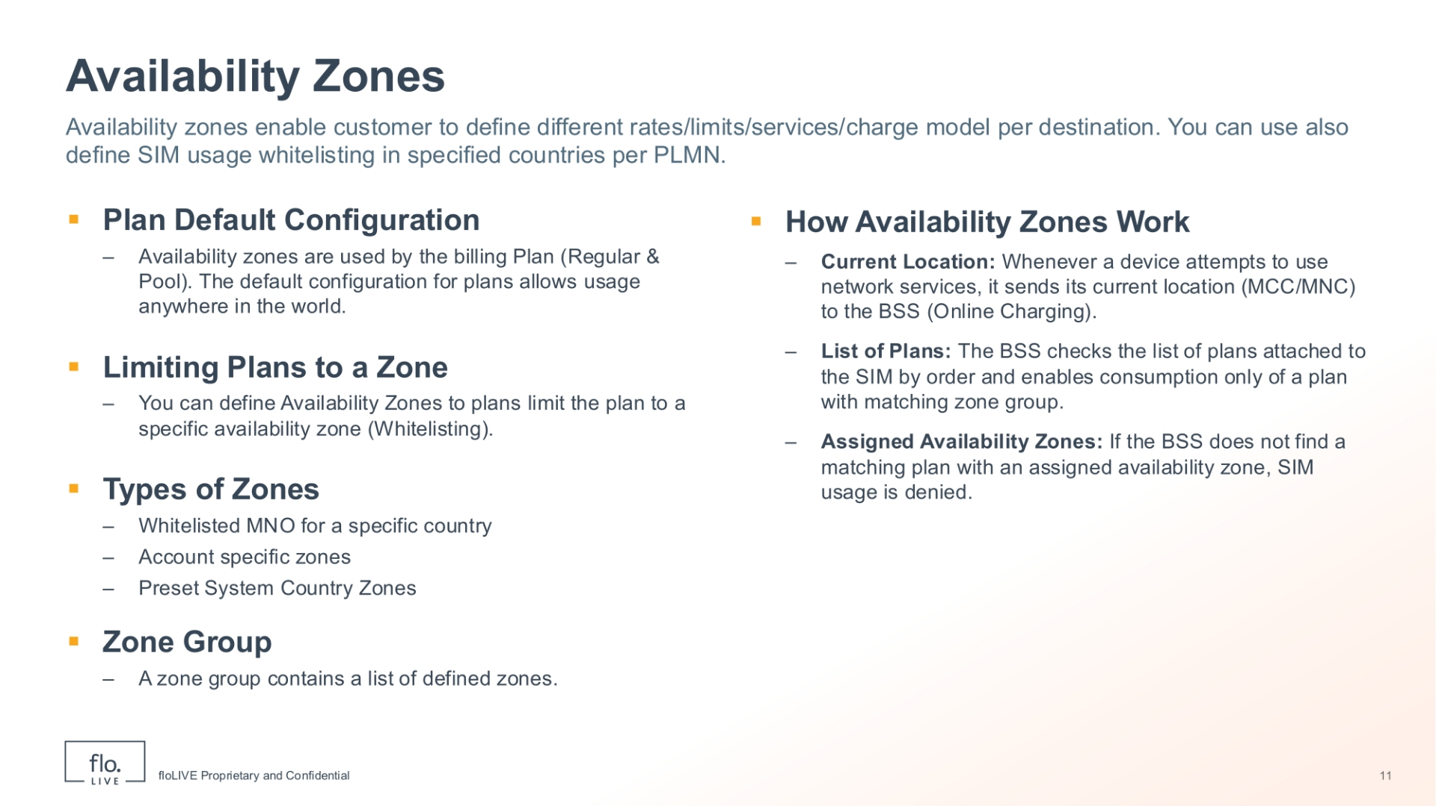
Notes:
Availability Zones enable you to define SIM usage based on a list of approved countries, and Public Land Mobile Networks. This feature also enables you to set different prices, usage limits, services, or charging rules based on the location of your SIMs.
As a general rule, SIM plans are eligible for use anywhere in the world. However, in many cases, you probably want to limit plans to a specific availability zone. This means you are permitting the usage of a SIM in certain countries and for specific PLMN operators. This method of providing access to a plan is called,"Whitelisting".
When you create an Availability Zone you need to define a list of approved Mobile Network Operators for a specific country. You can use Pre-set, system-defined Country Zones, or you can create Zone Groups, which are a collection of different country zones.

Slide 16
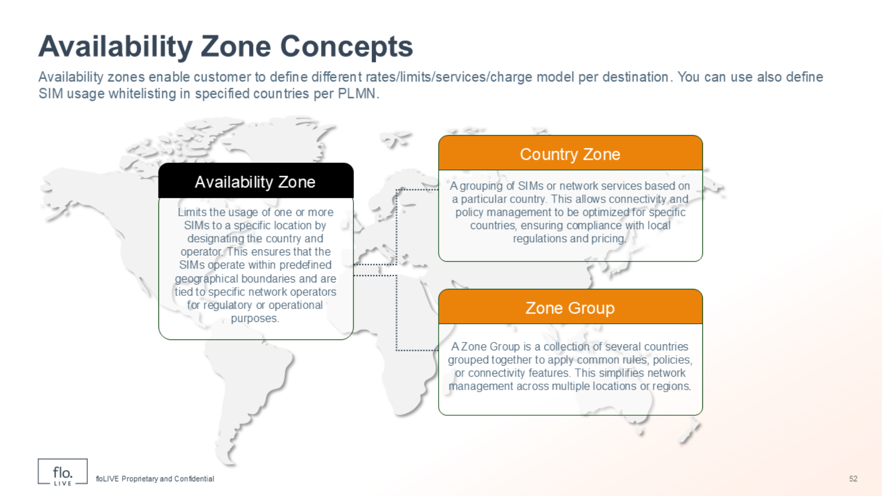
Notes:
Lets explore the key availability concepts. An Availability Zone enables the use of a plan only in defined countries and for specified network operators. A Country Zone limits the usage of SIMs to a specific country and operator in that country. A Zone Group is a collection of several country zones combined. The purpose is to apply common rules, policies, or connection features. A Zone Group is most suitable for managing connectivity charges across geographical regions.

Slide 17
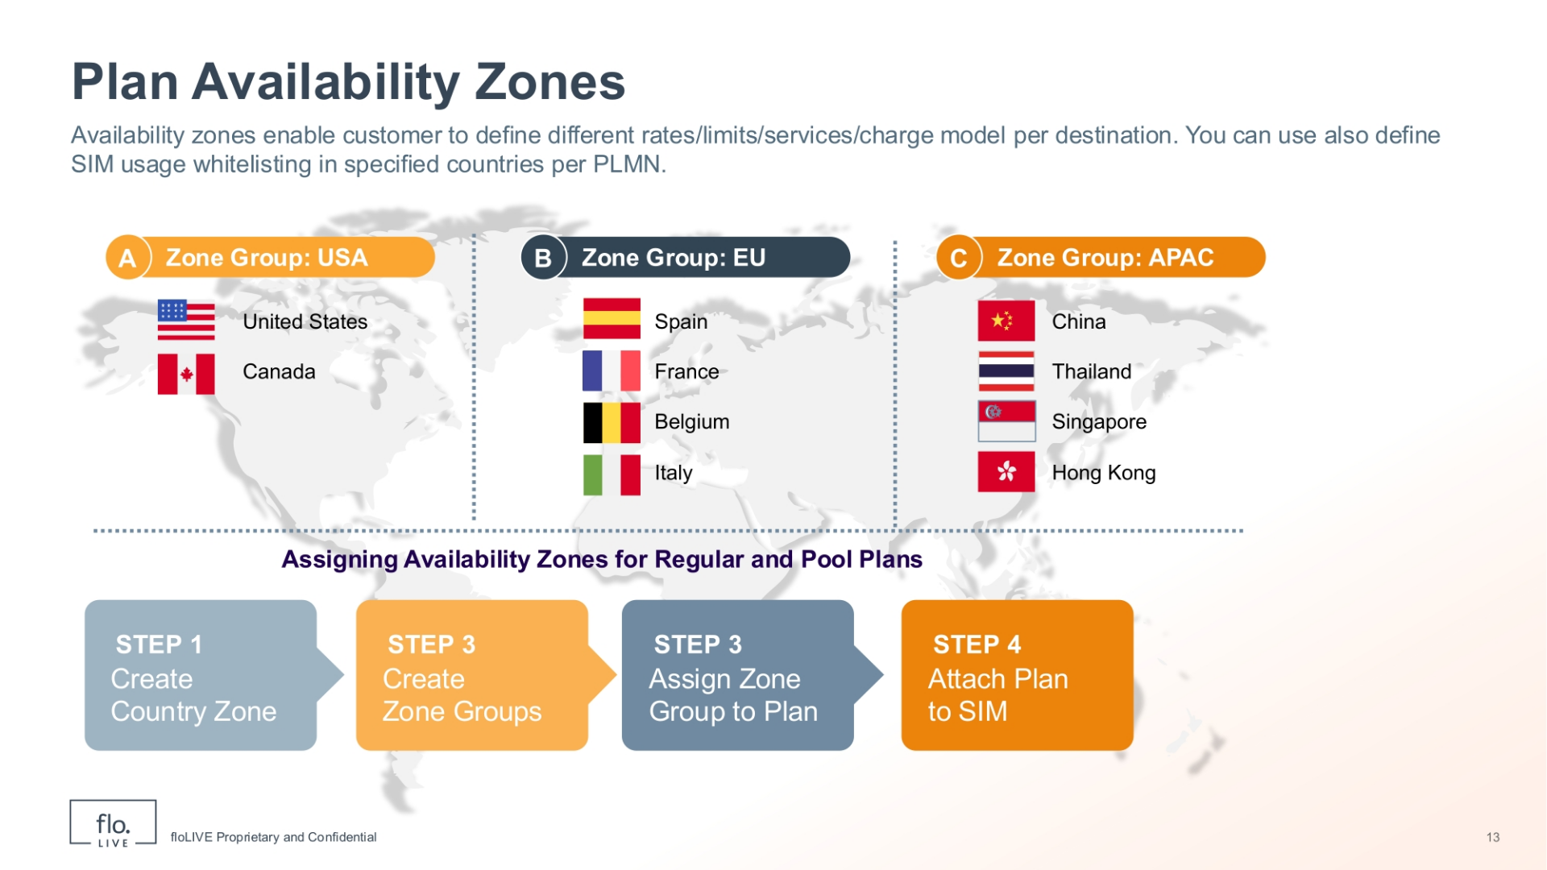
Notes:
In this slide, you can visualize how these availability zones are structured and grouped. The USA Zone Group applies to the United States and Canada. The EU Zone Group applies to Spain, France, Belgium and Italy. Finally the APAC Zone is limited to China, Thailand, Singapore and Hong Kong. Notice the flow diagram at the bottom of the screen. This diagram explains how the availability process works. First, you create one or more country zones. Next, you consolidate several country zones to create a Zone Group. Now you can apply the Zone Group to a Plan, and finally you can attach that plan to one or more SIMS.

Slide 18
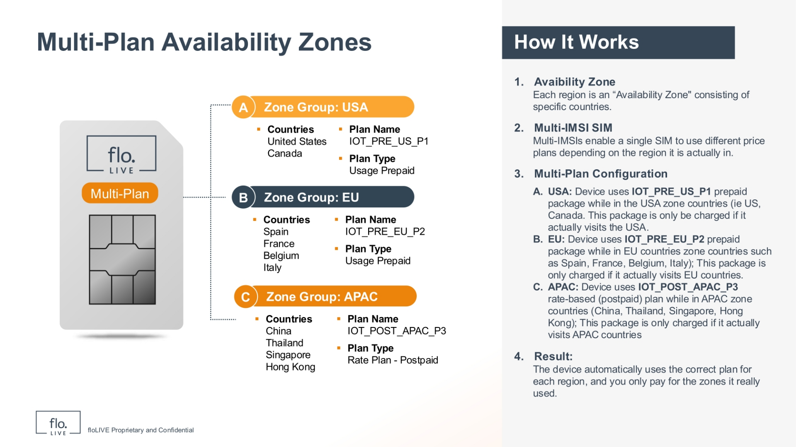
Notes:
By putting together Multi-Plans and Availability Zones, we get Multi-Plan Availability Zones. This advanced setup uses Multi-IMSI SIMs. These SIMs allow one SIM to use different price plans based on where it is in the world. In this example, the USA zone, includes the United States and Canada. The device uses a prepaid data package called IOT PRE US P1. This package is only charged if the device is actually used in the USA zone countries. Now, lets take a look at the the EU zone This zone includes Spain, France, Belgium, and Italy. Devices active in this zone use a different prepaid data package called IOT PRE EU P2. This package is only active and charged when the device is located in these EU countries.
Lastly, the APAC zone include China, Thailand, Singapore, and Hong Kong. The device uses a postpaid plan based on usage, called IOT POST APAC P3. This plan is only charged if the device is actually in these APAC countries.
This multi-plan setup shows that devices automatically use the appropriate plan when entering different regions. In each case, the SIM is only charged for the zones actually in use. This method enables customer to reduce costs, and makes sure thadevices maintain continual connectivity for any region in the world

Slide 19

Notes:
Thank you for watching this video tutorial. For more information about the CMP system, make sure you visit our Knowledge-base that is accessible directly from the CMP Portal.

